Slide 1
Big Data
Marlabs

Slide 2
Big Data In General
We’ve worked with Data that can fit on a local computer in the scale of 0-8 GB.
But what can we do if we have a larger set of data?
Try using a SQL database to move storage onto hard drive instead of RAM
Or use a distributed system, that distributes the data to multiple machines/computer.

Slide 3
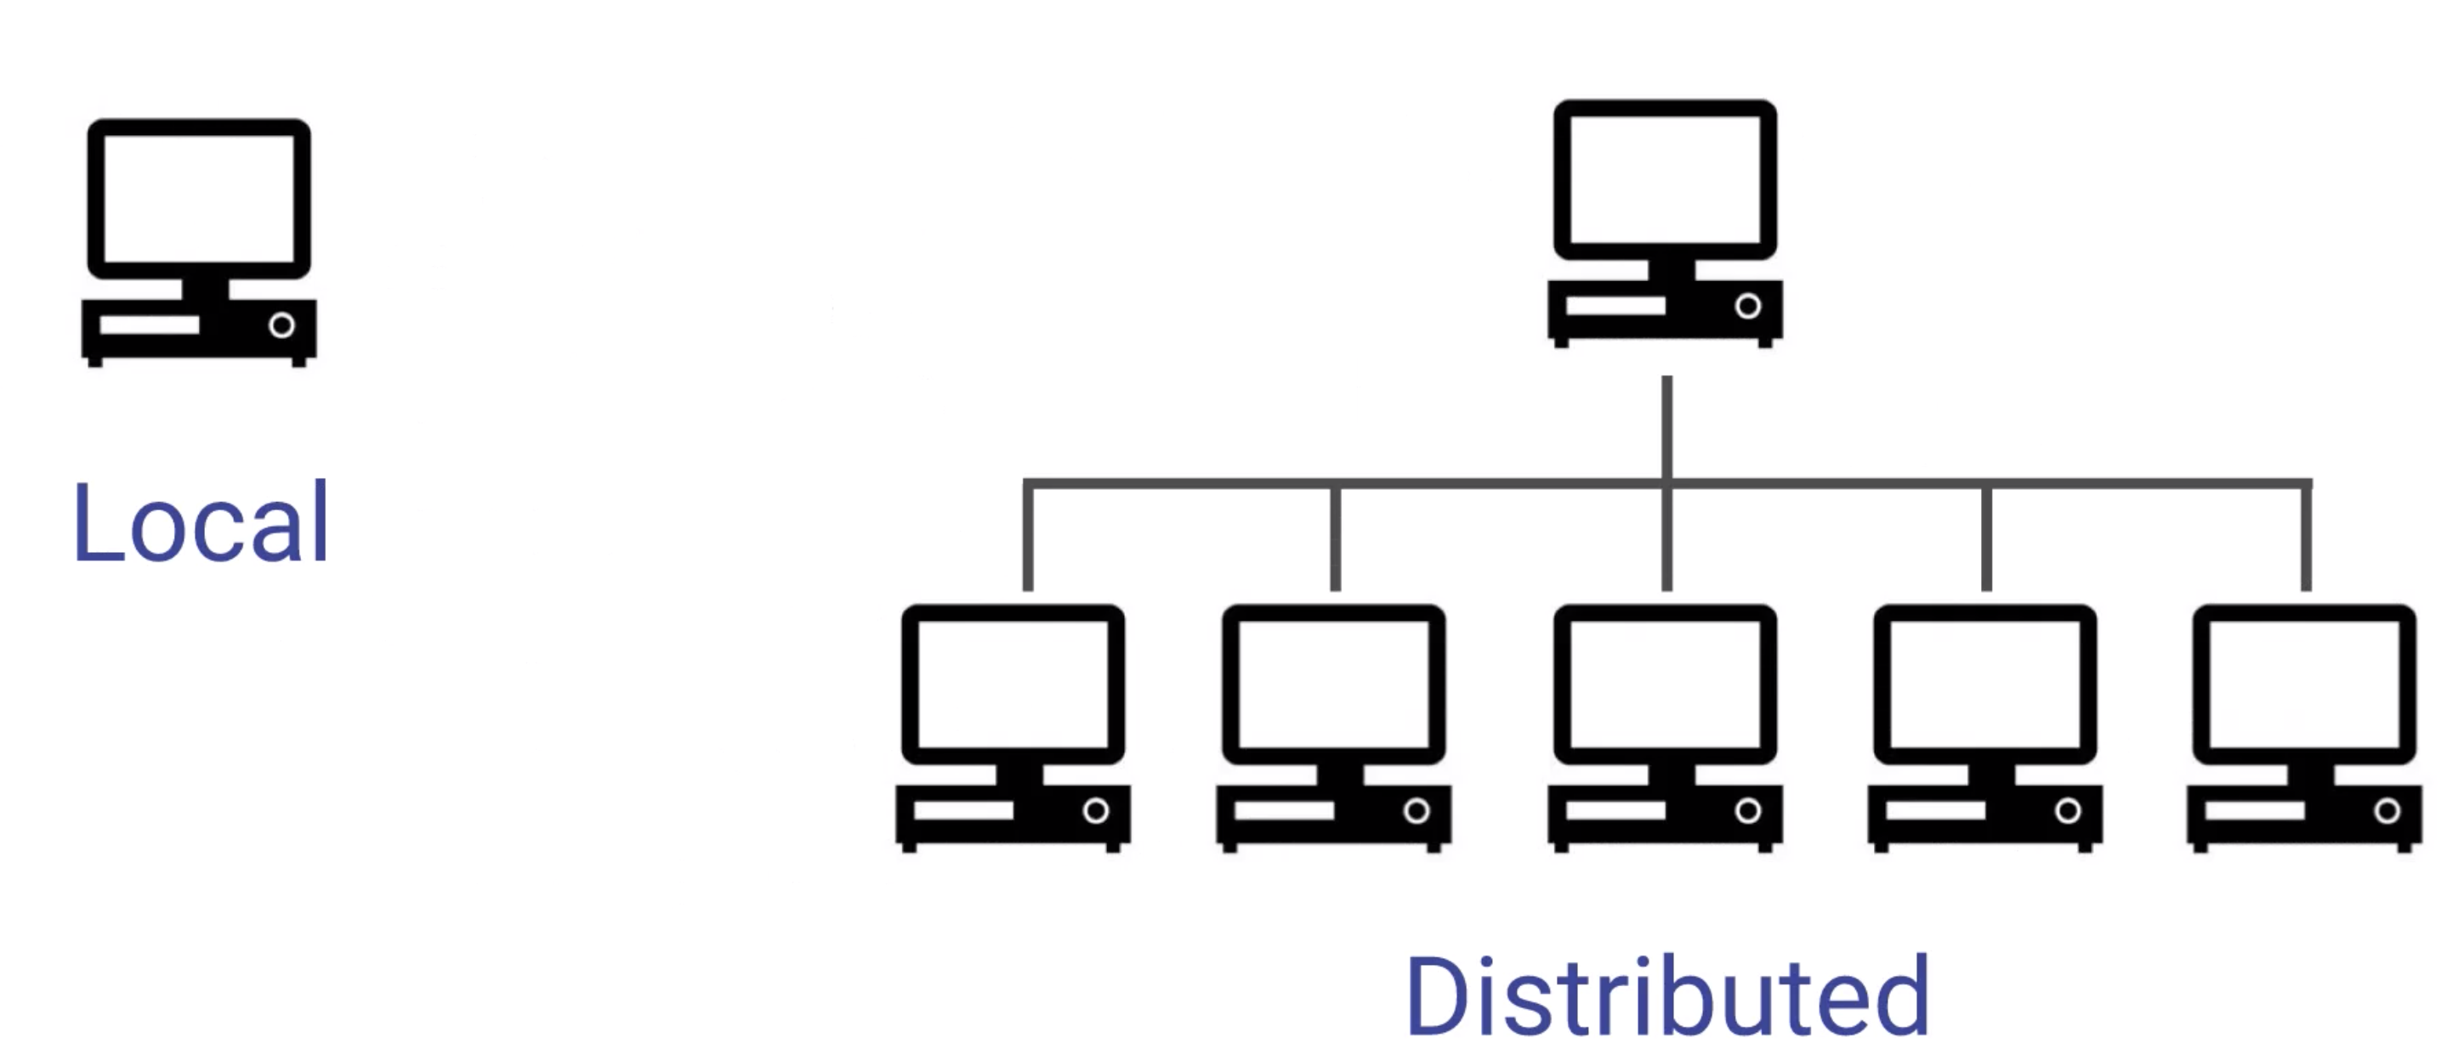
Local Versus Distributed
More processing power
More memory

Slide 4
Distributed Machines
A local process will use the computation resources of a single machine
A distributed process has access to the computational resources across a number of machines connected through a network.
After a certain point, it is easier to scale out to many lower CPU machines, than to try to scale up to a single machine with a high CPU.
Distributed machines also have the advantages of easily scaling, you can just more machines.
They also include fault tolerance, if one machine fails, the whole network can still go on.
Let’s discuss the typical format of a distributed architecture that uses Hadoop

Slide 5
Hadoop
Hadoop is a way to distribute very large files across multiple machines.
It uses the Hadoop Distributed File Systems (HDFS).
HDFS allows a user to work with large data sets
HDFS also duplicates blocks of data for fault tolerance
It also then uses MapReduce
MapReduce allows computations on that data

Slide 6
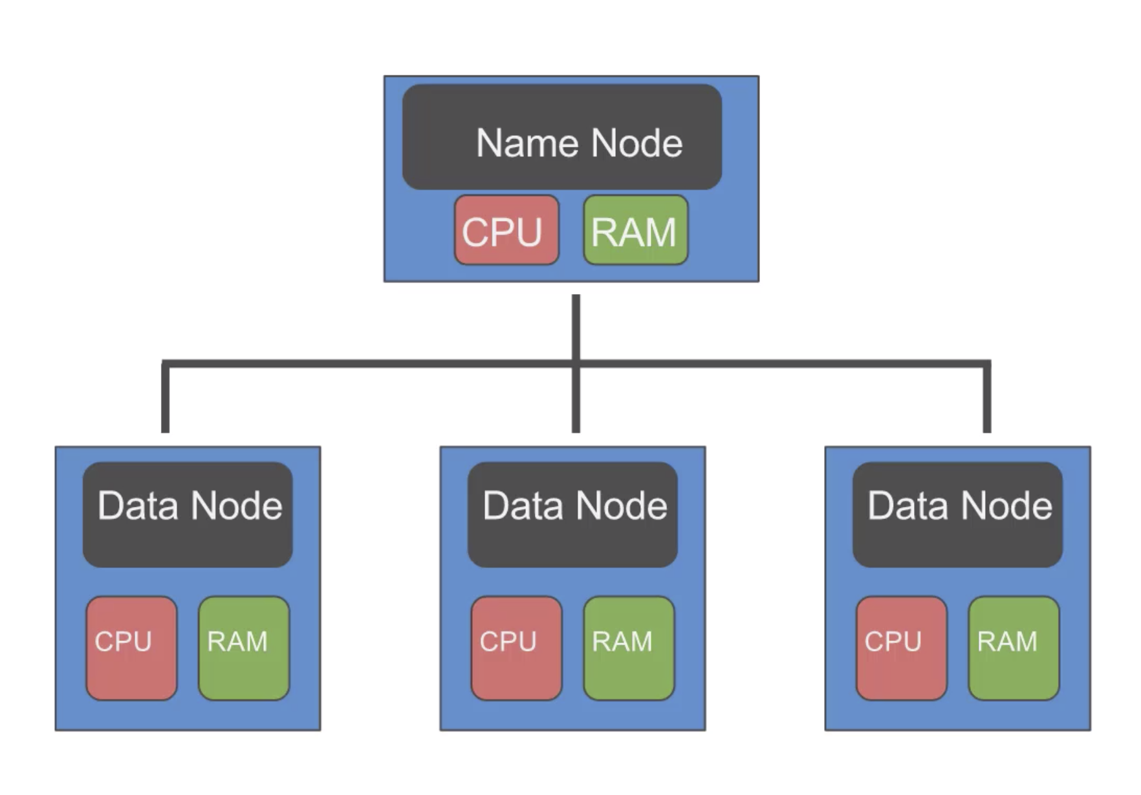
Distributed Storage - HDFS
HDFS will use blocks of data, with a size of 128 MB by default
Each of these blocks is replicated 3 times
The blocks are distributed in a way to support fault tolerance

Slide 7
Distributed Storage - HDFS
Smaller blocks provide more parallelization during processing
Multiple copies of a block prevent loss of data due to a failure of a node.

Slide 8
Distributed Storage - HDFS
The Job Tracker sends code to run on the Task Trackers
The Task Trackers allocate CPU and memory for the tasks and monitor the tasks on the worker nodes.

Slide 9
Using HDFS to distribute large data sets
Using MapReduce to distribute a computational task to a distributed data set.
Spark improves on the concepts of using distribution.

Slide 10
Spark

Slide 11
Spark In General
Spark is one of the latest technologies being used to quickly and easily handle Big Data
It is an open source project on Apache
It was first released in February 2013 and has exploded in popularity due to it’s ease of use and speed
It was created at the AMPLab at UC Berkely

Slide 12
Spark
You can think of Spark as a flexible alternative to MapReduce
Spark can use data stored in a variety of formats:
Cassandra
AWS S3
HDFS
And more

Slide 13
Spark VS MapReduce
MapReduce requires files to be stored in HDFS, Spark does not
Spark also can perform operations up to 100x faster than MapReduce
So how does it achieve this speed?

Slide 14
Spark VS MapReduce
MapReduce writes most data to disk after each map and reduce operation
Spark keeps most of the data in memory after each transformation
Spark can spill over to disk if the memory is filled

Slide 15
Spark RDDs
At the core of Spark is the idea of a Resilient Distributed Dataset (RDD)
Resilient Distributed Dataset (RDD) has 4 main features:
Distributed Collection of Data
Fault-tolerant
Parallel operation – portioned
Ability to use many data sources

Slide 16
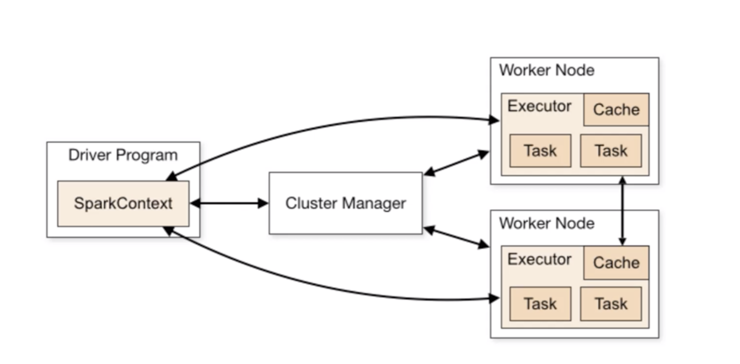
Spark RDDs
Cache() will cache the RDD into memory

Slide 17
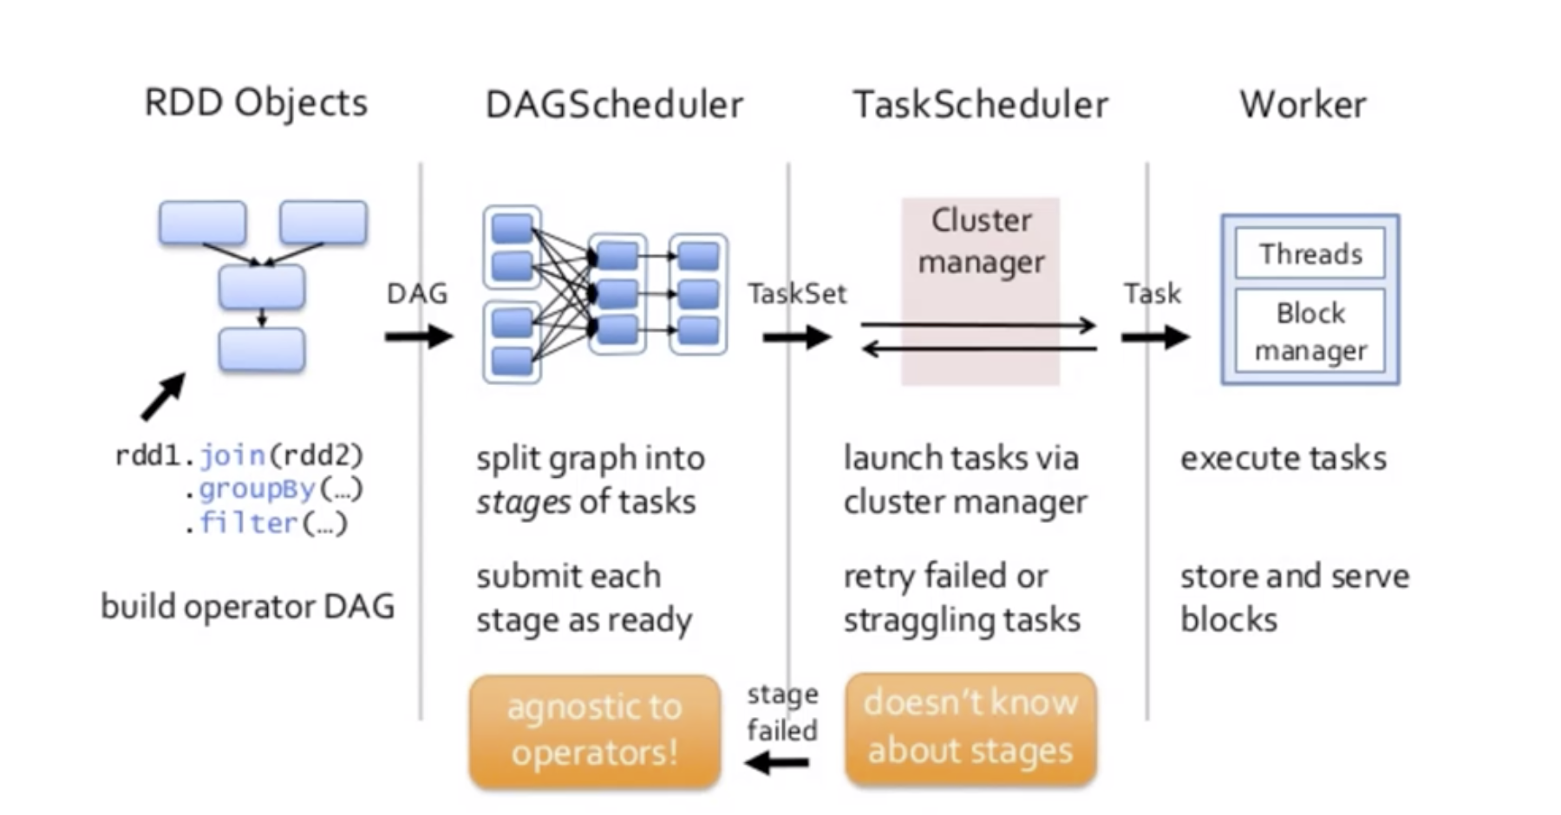
Spark RDDs

Slide 18
Spark RDDs
RDDs are immutable, lazily evaluated, and cacheable (A cacheable response is an HTTP response that can be cached, that is stored to be retrieved and used later, saving a new request to the server.)
There are two types of RDD operations:
Transformations
Actions
Basic Actions
First – return the first element in the RDD
Collect – return all the elements of the RDD as an array at the driver program
Count – return the number of elements in the RDD
Take – return an array with the first n elements of the RDD

Slide 19
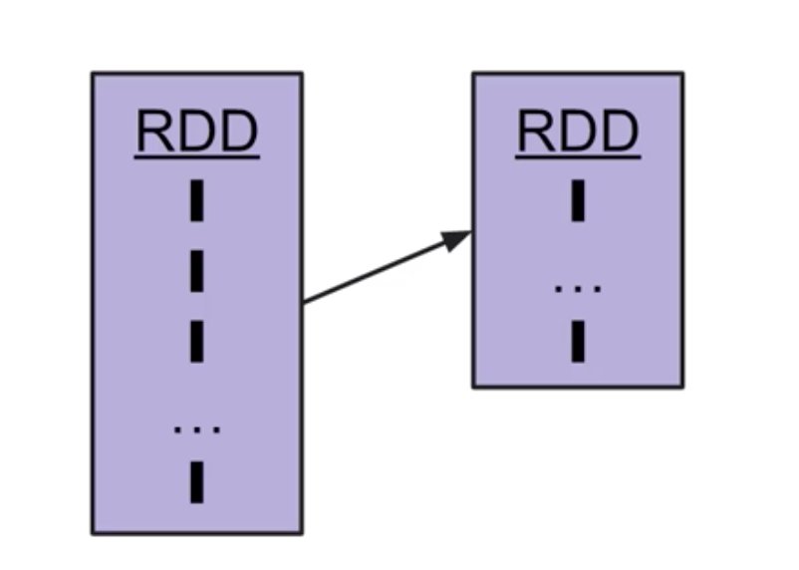
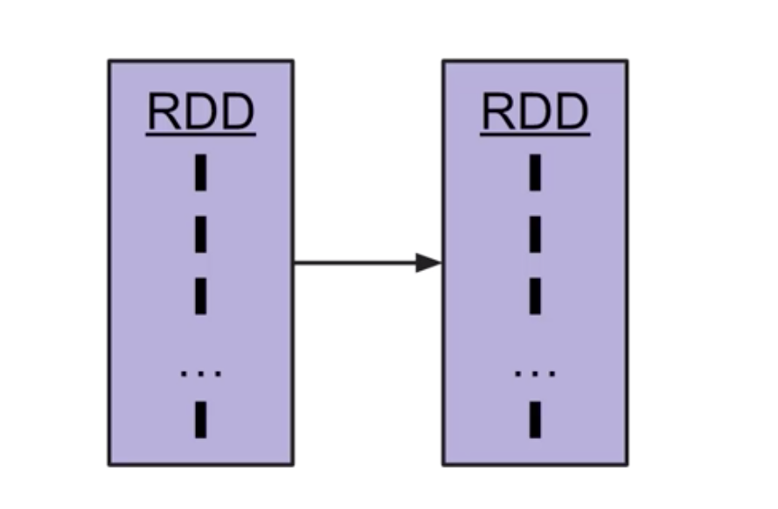
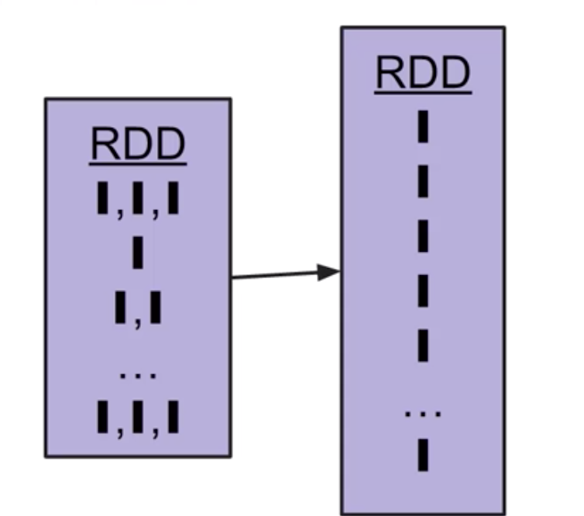
Spark RDDs
Basic Transformations:
Filter: RDD.filter() - applies a function to each element and returns elements that evaluate to true
Map: RDD.map() – transforms element and preservers # of elements, very similar idea to pandas.apply()
FlatMap: RDD.flatMap() – transforms each element into 0-N elements and changes # of elements

Slide 20
Map VS FlatMap
Map()
Grabbing first letter of a list of names
FlatMap()
Transforming a corpus of text into a list of words

Slide 21
Pair RDDs
Often RDDs will be holding their values in tuples:
(key, value)
This offers better partitioning of data and leads to functionality based on reduction

Slide 22
Reduce VS ReduceByKey
Reduce()
An action that will aggregate RDD elements using a function that returns a single element.
ReduceByKey()
An action that will aggregate Pair RDD elements using a function that returns a Pair RDD
These ideas are similar to a GroupBy operation

Slide 23
Spark Ecosystem
Spark SQL
Spark DataFrames
Mllib
GraphX
Spark Streaming

Slide 24
Spark DataFrames
Spark DataFrames hold data in a column and row format.
Each column represents some feature or variable.
Each row represents an individual data point.
Spark began with something known as the “RDD” syntax which was a little ugly and tricky to learn.
Now Spark 2.0 and higher has shifted towards a DataFrame syntax which is much cleaner and easier to work with!
Spark DataFrames are able to input and output data from a wide variety of sources.
We can then use these DataFrames to apply various transformations on the data.
At the end of the transformation calls, we can either show or collect the results to display or for some final processing.

